Slide 1
Reinforced Learning
Victoria Zabel, Learning Portfolio 8

Slide 2
Table of Contents
Introduction to Reinforced Learning
Basic Content
Practical Example

Slide 3
Introduction to Reinforced Learning
Solving control tasks
Learning from actions
Components:
Agent: an AIT
Goal: maximize its cumulative reward
Observation / State Space
Environment: first / new frames of game
Learning: interaction with environment
trial and error
Rewards: feedback method for performed actions
Notes:
solving control tasks (also called decision problems)
An agent (an AI)
With the goal of maximizing its cumulative reward, called the expected return.
State: is a complete description of the state of the world (there is no hidden information). In a fully observed environment.
Full like a chess board
Observation o: is a partial description of the state. In a partially observed environment.
Like a level of a video game
will learn from the environment
by interacting with it (through trial and error)
Actions: Possible actions in environment:
Discrete Space: finite actions
Continuous Space: infinite number of actions
receiving rewards (negative or positive) as feedback for performing actions.
Rewards allow the agent to understand what is correct and what isn’t, +1 for positives, -1 for negatives

Slide 4
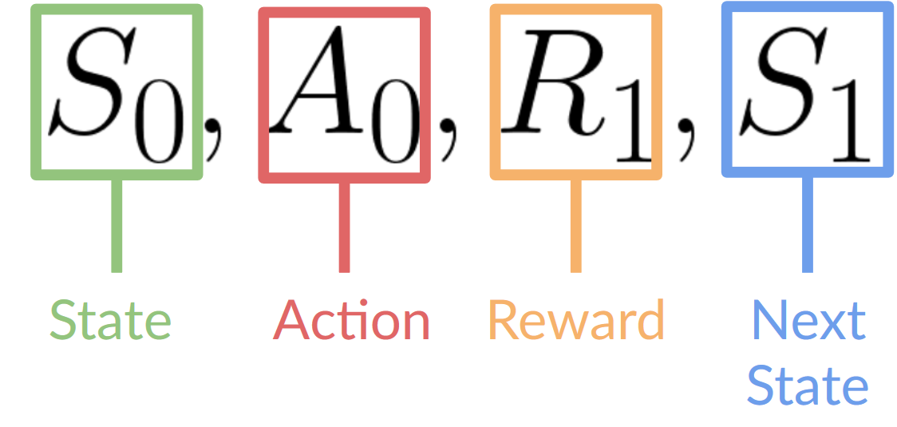
2. Basic Content
Notes:
This Reinforced Learning loop outputs a sequence of state, action, reward, and next state.
The initial phase is marked by 0’s with each loop increasing by 1
In this loop, our agent receives a state from the environment - first frame is presented, first state is S0
The agent takes its first action (A0) based on this state (jump, left, right, duck)
Results of this action are simultaneously rewarded with either a +1 or -1, R1
And the environment goes to a new state / frame, S1

Slide 5
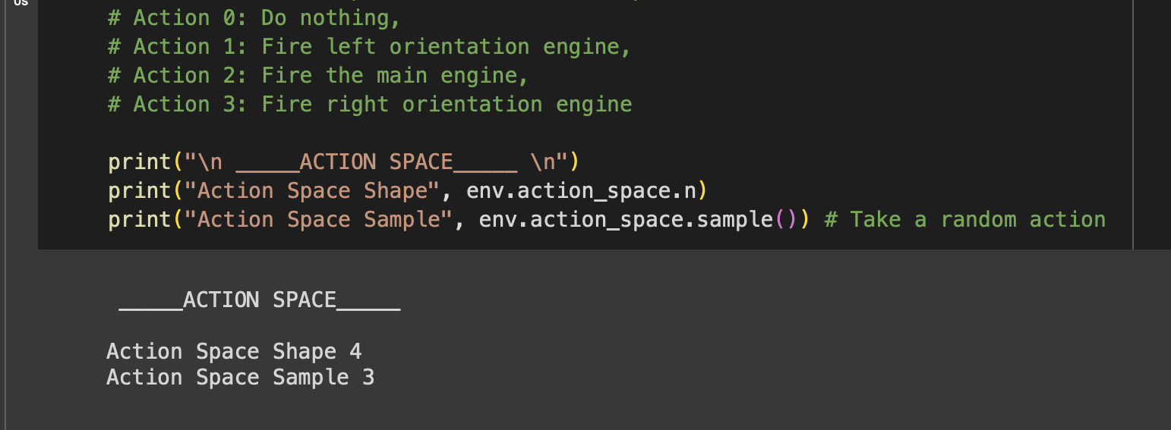
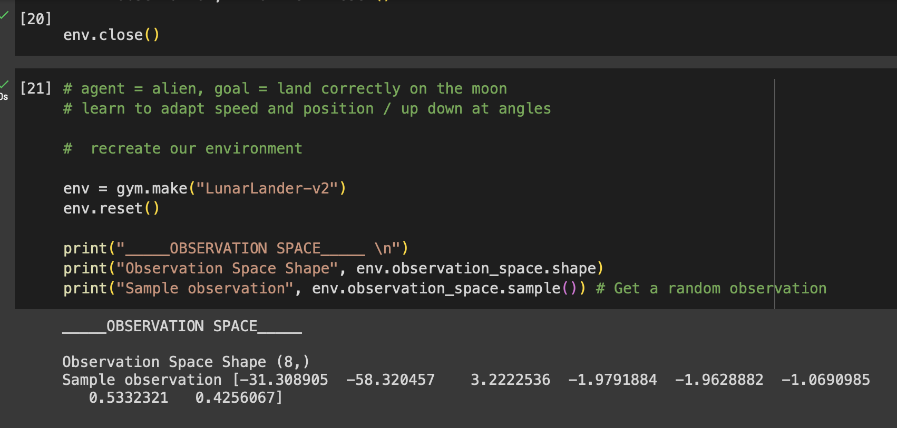
Discrete Action Space: limited to four action possibilities
Observation State: partially observed environment
One “level”

Slide 6
Markov Property
“Our agent needs only the current state to decide what action to take and not the history of all the states and actions they took before.”

Slide 7

Rewards and Discounting
Discount each reward to the exponent of the time step:
Define gamma (0 - 1)
The larger the gamma, the smaller the discount
The larger the gamma, the smaller the discount
Notes:
To discount the rewards:
define a discount rate gamma. It must be between 0 and 1. Most of the time between 0.95 and 0.99.
The larger the gamma, the smaller the discount = our agent cares more about the long-term reward.
the smaller the gamma, the bigger the discount = our agent cares more about the short term reward (the nearest cheese).
Then, each reward will be discounted by gamma to the exponent of the time step. As the time step increases, the future reward is less and less likely to happen.
The rewards that come sooner (at the beginning of the game) are more likely to happen since they are more predictable than the long-term future reward.

Slide 8
Episodic vs. Continuing Tasks
Terminal state
Starting and end point
Use known information
maximize the reward
Random actions
find more information about the environment.
No terminal state
Infinite, continuous task
Exploitative vs. Explorative Approach
Notes:
Exploration-Exploitation Trade-Off: It balances how much we want to explore the environment and how much we want to exploit what we know about the environment.
A higher entropy coefficient encourages the policy to explore more, while a lower value encourages exploitation.
Values range from 0 to 0.01

Slide 9
Policy Based vs. Value Based Methods
Direct learning of policy function
Deterministic:
a policy at a given state will always return the same action.
Stochastic:
output a probability distribution over actions for best fit
Indirect learning, learn a value function
Value of a state: expected discounted return if agent starts in that state
Acts on biggest value defined by the value function to attain goal
Notes:
To solve an RL problem, you want to find an optimal policy.
The policy is the “brain” of your agent, which will tell us what action to take given a state.
The optimal policy is the one which gives you the actions that maximize the expected return.

Slide 10
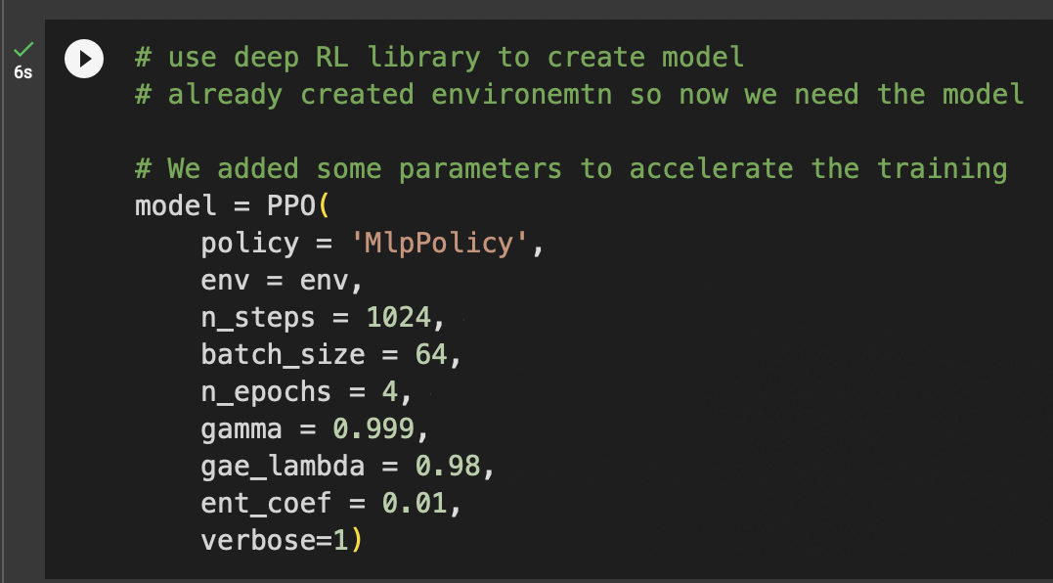
policy = which method
env = use previous environment
n_steps = number of interactions agent will have with the environment before collecting experience to update its policy
gamma = discount rate, higher so smaller discount = our agent cares more about the long-term reward
ent_coef = exploration / exploitation trade off = exploiting here
Notes:
policy = which method
env = use previous environment
n_steps = number of interactions agent will have with the environment before collecting experience to update its policy
gamma = discount rate, higher so smaller discount = our agent cares more about the long-term reward
ent_coef = exploration / exploitation trade off = exploiting here

Slide 11
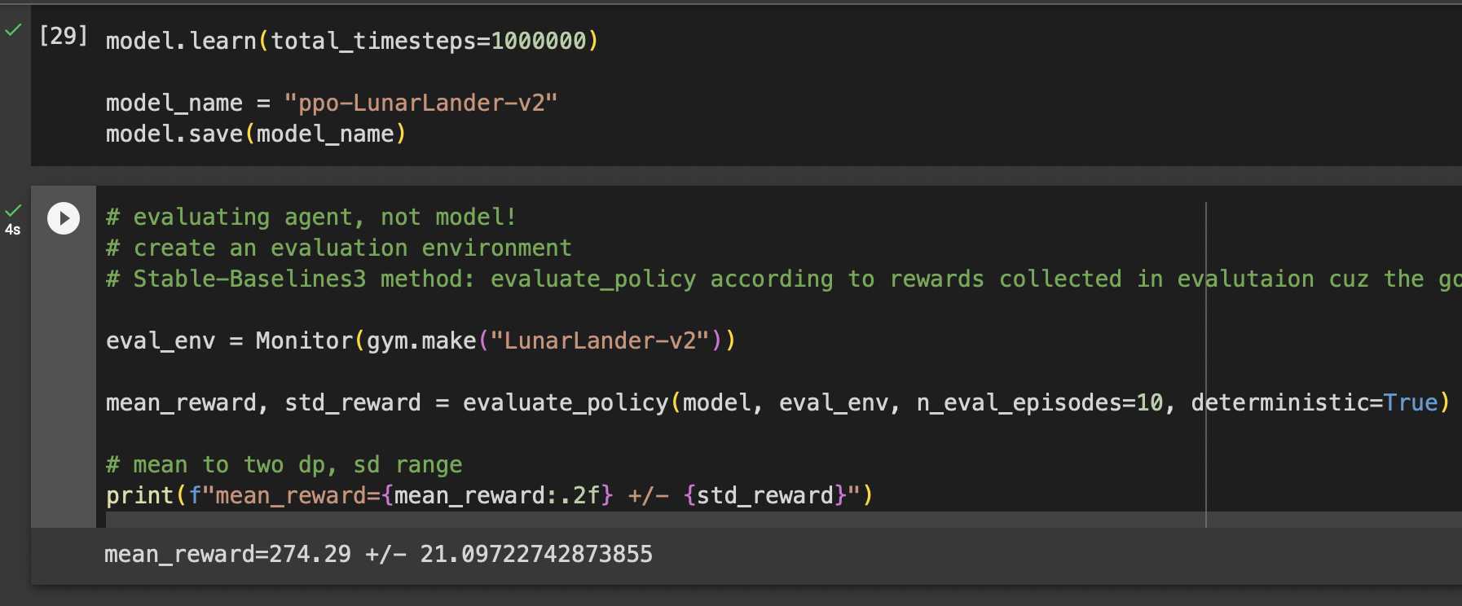
Rewards: 274.29
“An episode is considered a solution if it scores at least 200 points”
using prev model, new environment
evaluation episodes = 10, policy will be evaluated for 10 episodes
determ = True, the policy will select the actions with the highest probability / = False, value based/ Acts on biggest value to attain goal

Slide 12
Overall Learnings
What Reinforced Learning is
Its components
How to use it
Generally entirely new concept for me
Liked that it had more of a gamification aspect
Easy to interpret
Similar to other models but here the agent is trained and evaluated rather than the model
Not training and test sets but training and evaluation environments

